Slide 1
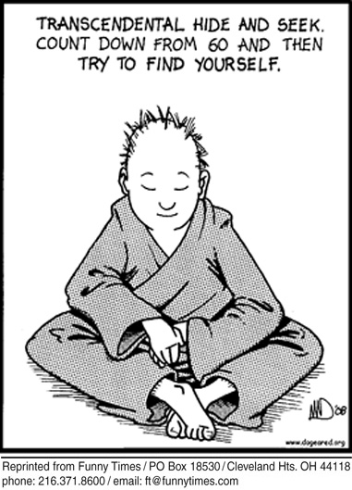
TPCASTT and Transcendentalist Analysis by Teja Wiggins-McKinney and Anna Katogiritis

Slide 2
Miracles-Walt Whitman
Why, who makes much of a miracle?
As to me I know of nothing else but miracles,
Whether I walk the streets of Manhattan,
Or dart my sight over the roofs of houses toward the sky,
Or wade with naked feet along the beach just in the edge of the water,
Or stand under trees in the woods,
Or talk by day with any one I love,
or sleep in the bed at night with any one I love,
Or sit at table at dinner with the rest,
Or look at strangers opposite me riding in the car,
Or watch honey-bees busy around the hive of a summer forenoon,
Or animals feeding in the fields,
Or birds, or the wonderfulness of insects in the air,
Or the wonderfulness of the sundown,
or of stars shining so quiet and bright,
Or the exquisite delicate thin curve of the new moon in spring;
These with the rest, one and all, are to me miracles,
The whole referring, yet each distinct and in its place.
To me every hour of the light and dark is a miracle,
Every cubic inch of space is a miracle,
Every square yard of the surface of the earth is spread with the same,
Every foot of the interior swarms with the same.
To me the sea is a continual miracle,
The fishes that swim--the rocks--the motion of the waves--the ships with men in them,
What stranger miracles are there?

Slide 3
-Title
-Title
When first looking at this poem, the title “Miracles” seems to imply something extraordinary, and perhaps even supernatural or religious. The title makes us think that it may be about a large event in the writer’s life.

Slide 4
-Paraphrase
In miracles, Walt Whitman goes through the events of his day and talks about how every thing in life is simply a miracle.

Slide 5
-Connotation
Whitman starts almost every line in with the word “or”, as if he has a never-ending list of “miracles” in his mind. Every little aspect in life we humans take for granted, he views it as a miracle.

Slide 6
-Attitude
-Attitude
Whitman lists many every day experiences as “miracles”. He takes a passive, matter-of-fact approach, stating that all experiences are miracles in their own ways. Yet, it’s also obvious that Whitman is appreciative of life in general. It’s almost as if he romanticizes it.

Slide 7
-Shifts
-Shifts
At the beginning of the poem, Whitman states examples of things that any person can be doing at any given time. Then towards the end of the poem he shifts from saying “Or” at the beginning of each line to stating his opinion of what a miracle is.

Slide 8
-Title
-Title
Now after reading the poem, I interpreted the title miracles as life. Life itself is a miracle and he gave us reasons to believe why so.

Slide 9
-Theme
-Theme
Every moment of every day is special and should be cherished.

Slide 10
Tenants of Transcendentalism
Every person should follow their own intuition, rather than overthinking situations.
Every individual needs to be self-reliant.
We must live in the here and now.
Society is a source of corruption.
Knowledge comes from experience.
The nature of human beings is good.

Slide 11
We must live in the here and now.
The tenant of transcendentalism that most relates to Miracles by Walt Whitman is the tenant of living in the moment and “going with the flow”. Whitman relates each everyday moment to a miracle, obviously treating every moment as a gift. He lives in every single moment, treasuring each experience that he is faced with daily.

Slide 12
Intuition is important-Don’t overthink life
In Miracles, Whitman describes every day simplicities as miracles. Rather than overanalyzing his life, he lives simply in each moment, and enjoys everything that he gets to experience. He does not analyze and criticize his experiences. Rather, he follows his heart and immerses himself in every experience possible. It is clear through lines in the poem such as “Or look at strangers opposite me riding in the car” that Whitman enjoys every moment of life without overanalyzing it.

Slide 13
Knowledge comes from experience.
Without his own experiences, the author would not be able to narrate this poem. Every line in the poem is a personal experience of the author, as he uses sensory information and description to relay his own thoughts and memories to the reader. The author uses a list-like format, followed with a description of what a “miracle” is. Because of this, the reader can tell that the narrator’s experiences are what gave him the knowledge of “miracles” and how to experience them. The author has learned by experience how to live his life.

Slide 14
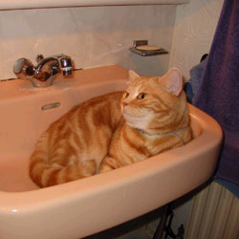
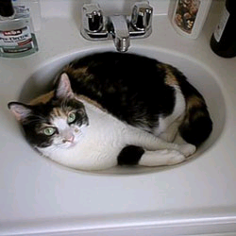
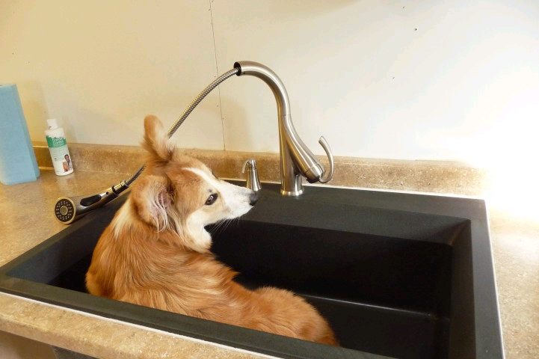
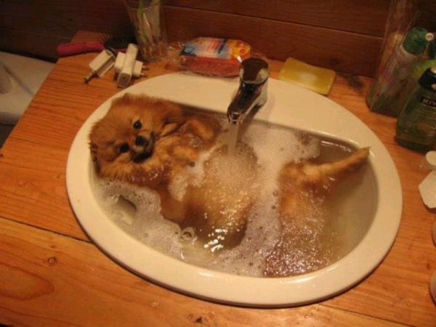
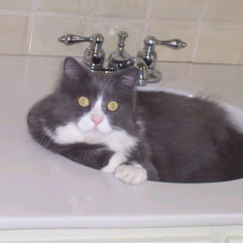
The End! Now you may enjoy some pictures of cats and dogs in sinks.

Slide 15
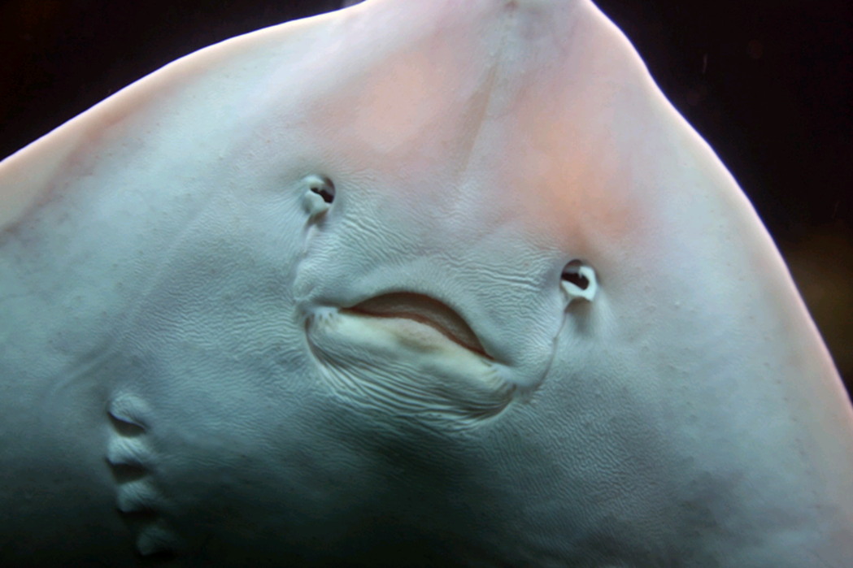
GOODBYE

